Slide 1


Bizi Fruit
By - Amanda Binu
Salvatore DiMaggio
IIITI 200 -Intro to Cloud Computing
Professor: Dr. Thiago Ferreira

Slide 2




MEET THE TEAM
AMANDA BINU
JUSTIN WAREHAM
Information Technology and Informatics major
Information Technology and Informatics major
SAL DIMAGGIO
Information Technology & Informatics Major
Minor: Data Analytics

Slide 3
A lot of people in the United States, do not have the time or money to explore the world and try fruits from different regions of the world.
Notes:
:

Slide 4
SOLUTION
Bizi Fruit ships unique fruit from all over the world to the United States making it more accessible to enjoy good quality fruits of all varieties. Many of our fruits come from small organic farms to maintain the authenticity of the regions fruit. Other fruits are imported from countries or states with the best climates suitable for growing the fruit. We specialize in offering fruits that are not common in grocery stores and ship them directly to your door!
We make this service possible by using AWS to host the website so it can be accessed worldwide.
Notes:
:

Slide 5
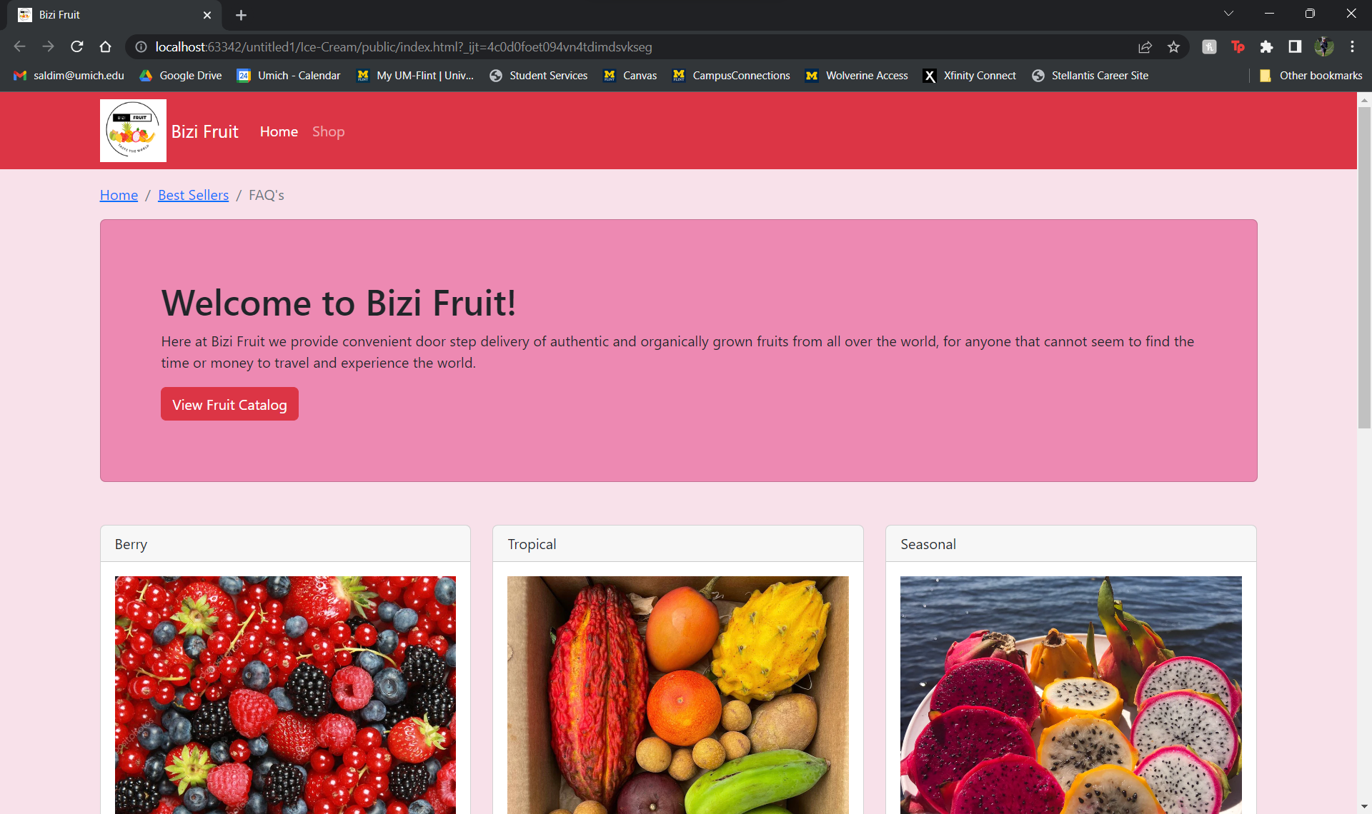
DEMO

Slide 6
LESSONS WE LEARNED
How to incorporate a front-end html file to backend functions and storing on the cloud through AWS
How to use bootstrap to create a friendly front end UI for the user
How to use a EC2 server to send data to the backend by using post requests
<Divs> are very important for structuring
How to run a database, server and files in the cloud.

Slide 7
ISSUES AND CHALLENGES ENCOUNTERED
Connecting the front end to backend
We had difficulty in outputting a “order has been placed” message for the user once they had placed an order
When adding the “Place Order” features into the html file we had difficulty with structuring it correctly
There is no indication that the form was submitted
Not being able to use eduroam

Slide 8
FUTURE VERSIONS
Bizi Fruit ships worldwide!
We want to include a landing page for the “Place order and checkout” process
We want to add a message display for when an order to placed
We want each order placed to be followed up with a confirmation number as well as tracking information
We want to provide a customer care service

